Slide 1

WALMART DATA ANALYSIS Submitted to: Jose Alvarez, BScEE, MBA April 2024
Group 7:
YOGESH MUPPIRI
ATUL SATHYA KOUTILYA MADDURU
SIRIJA NUKALA
SRAVAN KRISHNA CHOWDARY VEMULAPALLI
ARAEL FAYE PERRY

Slide 2
Research Overview
Project Background
Context of the Issue
Dataset Overview and Cleaning
Exploratory Data Analysis (EDA)
Correlation Analysis
Impact of Variables
Using Machine Learning Models
User Interface and Application
Conclusion

Slide 3



Project Background
Walmart is an American multinational retail corporation that operates a chain of hypermarkets, discount department stores, and grocery stores in the United States, Walmart was founded by Sam Walton in 1962
Walton's business strategy focused on lowest prices anytime, anywhere with low-cost, high-volume model, which contributed to the rapid expansion.
Walmart operates more than 10,500 stores and eCommerce websites in 19 countries. Walmart employ 2.1 million associates around the world.
Walton's different stores:
Walmart Supercenter (1988)
Walmart Discount Store (1962)
Walmart Neighborhood Market (1998)
Walmart made easier for customers to find what they need right at their fingertips. With innovations like Walmart plus, Curbside Pickup, Mobile Scan & Go and a whole host of apps.
With 90% of the U.S. population living within 10 miles of our stores

Slide 4
Walmart History
1960’s
1962 - On July 2, 1962, Sam Walton opens the first Walmart store in Rogers, Arkansas.
1969 - The company officially incorporates as Wal-Mart Stores, Inc.
1970’s
1970 - Walmart becomes a publicly traded company. The first stock is sold at $16.50 per share.
1978 - First pharmacy opens
1980’s
1980 - Walmart reaches $1 billion in annual sales, faster than any other company at that time. Walmart has 276 stores and employs 21,000 associates.
1987 - The company installs the largest private satellite communication system in the U.S.
1988 - The first Walmart Supercenter opens in Washington, Missour.
1990’s
1991 - Through a joint venture with Cifra, a Mexican retail company, Walmart goes global, opening a Sam's Club in Mexico City.
1992 - Rob Walton becomes chairman of the board.
2000’s
2000 - H. Lee Scott, Jr. succeeds David Glass as CEO. Walmart.com is founded
2006 - Walmart introduces its $4 generic-drug prescription program.
2010’s
2010 - Bharti Walmart, a joint venture, opens its first store in India
2019 - John Furner named President and CEO of Walmart U.S. First Walmart Health Center opens
1998 - The Neighborhood Market format is Introduced
1983 The first Sam's Club opens
Sam Walton passed away in 1992

Slide 5

Context of the issue
we aim to analyse the data collected by Walmart from 45 of its stores over certain time intervals. primary goal is to identify the key factors contributing to their sales. We'll investigate whether holidays, fluctuations in fuel prices, or changes in temperature have a significant impact on sales. Based on our findings, Walmart can explore alternative strategies to enhance their sales performance.
The hypothesis that we are finding in this project:
Does the rise in fuel prices discourage customers from visiting the store?
Do the weather changes prevent the customer from visiting the store?
Does the store sales increases during holidays sessions? (ex. Black Friday, labour day, snowfall, and Christmas etc)
Does the level of unemployment affect store sales?

Slide 6
Data Overview and Cleaning
Dataset sources and cleaning:
Features (temperature, fuel price, unemployment, store size and holiday )
store (store type and size)
Train (weekly sales, department and holiday)
Identify Missing Values
Imputation
Data Type Conversion
Outlier Detection
Normalization and Scaling
Data Merging
Removing Duplicates
Data Consistency

Slide 7
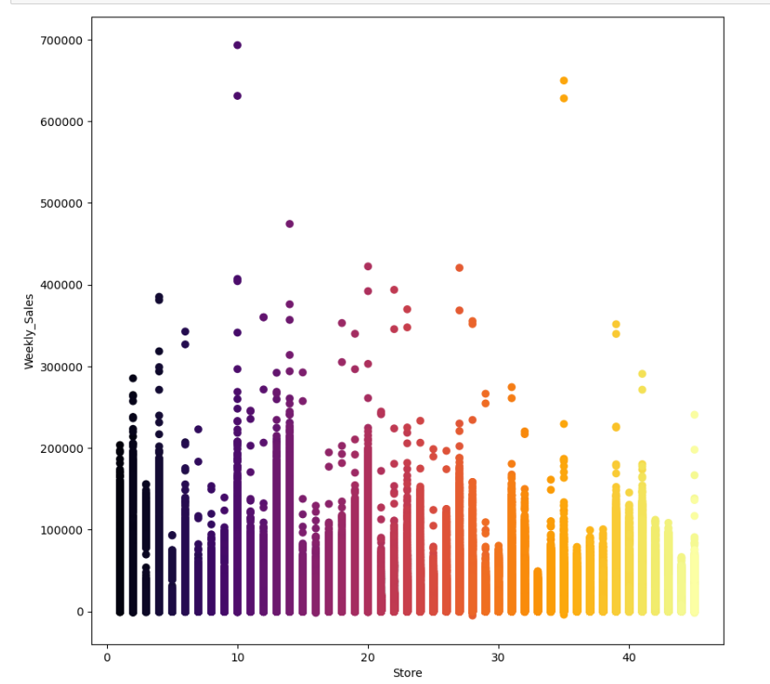
Exploratory Data Analysis (EDA)
Weekly sales over different store
Some stores have consistently high weekly sales, indicating strong customer traffic, good location, or effective marketing. Others with lower sales might require improvement in store management, product range, or location-based strategies

Slide 8
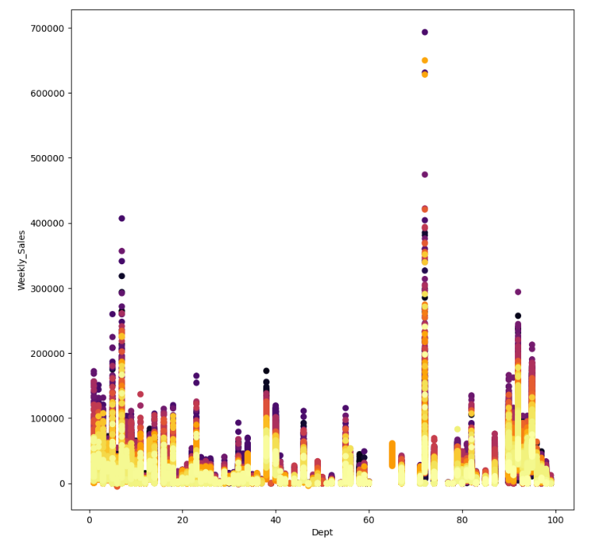
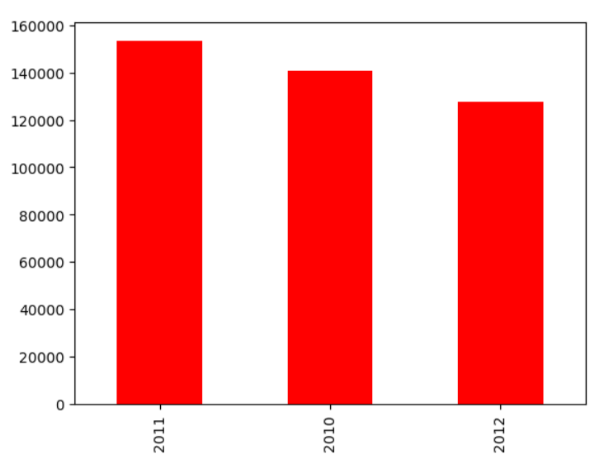
Relationship between weekly sale Vs each department
Some departments show higher sales spikes, indicating high-selling items, special promotions and suggesting they are popular or have high-demand products.
Overall sales per year (2010, 2011 and 2012)
The highest among the three years, suggesting that this year had strong performance in terms of revenue generation. Factors contributing to this peak could be seasonal trends, new product releases, or marketing campaigns that were particularly successful.

Slide 9
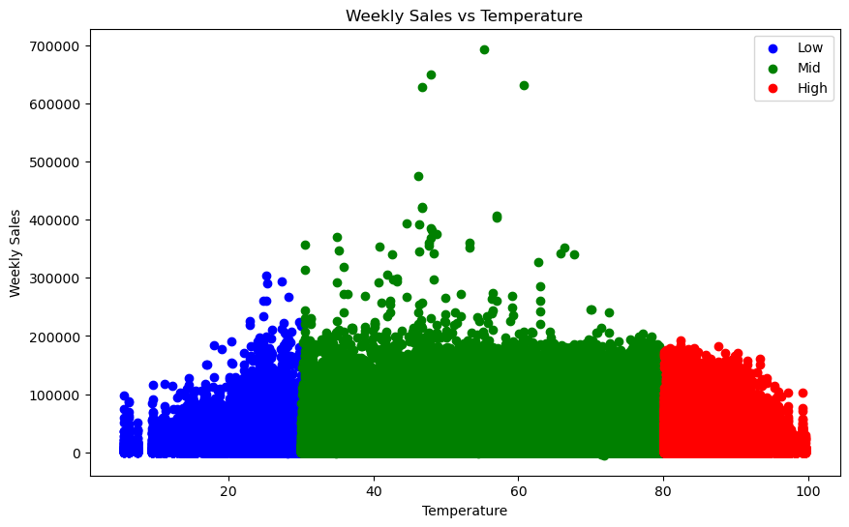
Correlation Analysis
Weekly sales Vs Temperature
In general, sales appear to increase with temperature, peaking around the mid-temperature range. Sales tend to decrease as temperature reaches higher levels, suggesting that there might be an optimal temperature range for high sales. The highest sales are seen in the green zone, corresponding to mid-range temperatures (around 40 to 60 degrees). This could indicate that moderate weather conditions encourage more customer activity and higher sales.

Slide 10
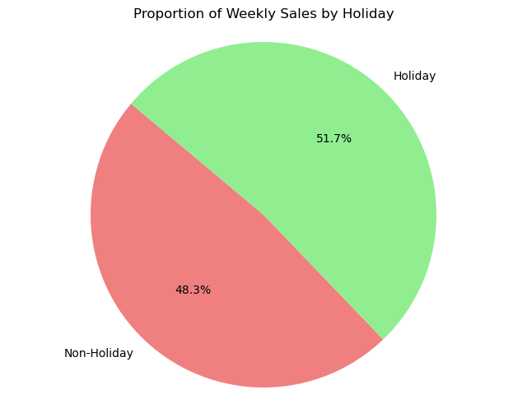
Weekly sales during holiday weeks Vs non-holiday weeks
Pie Chart indicates that holiday weeks have a slightly higher impact on sales compared to non-holiday weeks where holidays drive more customer spending.
Although the proportion of sales is lower during non-holiday weeks, they still contribute a significant share of revenue (48.3%). Retailers should maintain a consistent sales strategy during non-holiday periods to ensure a stable revenue stream.

Slide 11
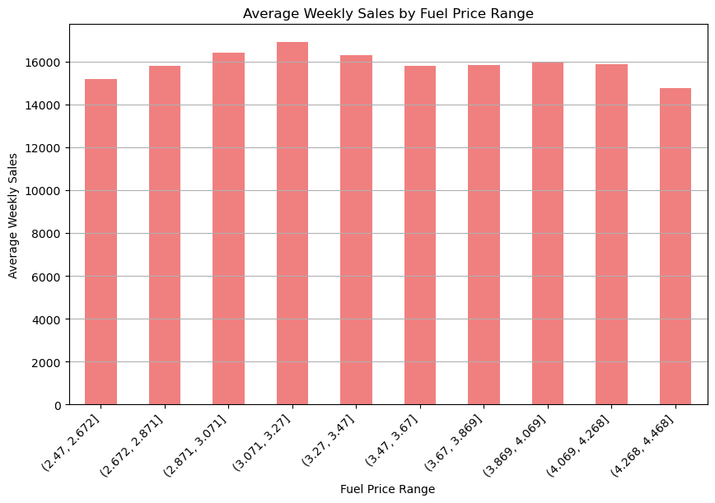
Weekly sales Vs Fuel price
The weekly sales show a relatively stable pattern across the different fuel price ranges. There might be slight fluctuations, but overall, the average weekly sales seem constant regardless of fuel prices. This stability suggests that fuel price fluctuations don't significantly impact weekly sales, indicating that consumer purchasing behaviour remains consistent.

Slide 12
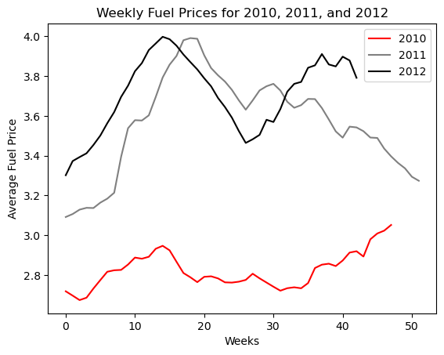
Weekly Fuel Prices over years (2010, 2011, 2012)
Fuel prices generally increase year by year due to a combination of factors such as inflation, changes in global oil prices, and geopolitical events. Inflation drives up the cost of goods and services over time, including fuel. Global oil prices are influenced by supply and demand dynamics leading to a gradual increase year by year.

Slide 13
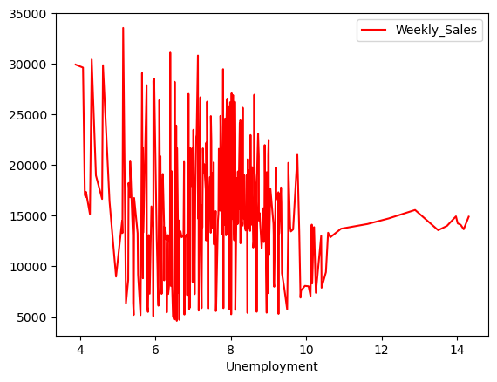
Relationship between unemployment rates and weekly sales
There's noticeable fluctuation in weekly sales across different levels of unemployment. At lower unemployment rates (around 4 to 8), weekly sales are more variable.
As unemployment rates rise (above 8), weekly sales show a downward trend. This aligns with general economic theory, where higher unemployment typically leads to reduced consumer spending, impacting retail sales. External economic conditions, such as inflation or market trends, might also play a role in affecting weekly sales.

Slide 14

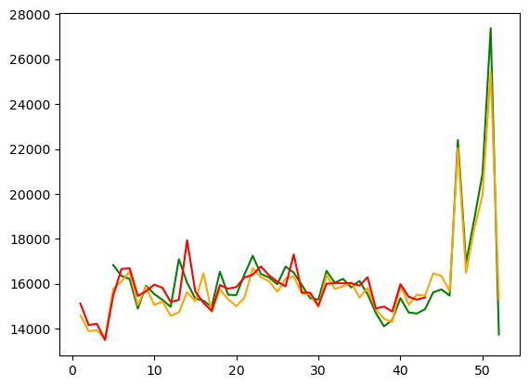
Weekly sales over the year
The chart tells quarter four holds higher sales, Higher sales towards the end of the year often reflect seasonal trends, such as holiday shopping. Events like Black Friday, Cyber Monday, and Christmas contribute to increased consumer spending. This pattern is common in retail, where the fourth quarter typically sees the most sales activity. Businesses often run major marketing campaigns and promotions in the final months of the year, aiming to boost sales during the holiday season. This could include discounts, special offers, and holiday-themed marketing, which drive increased customer traffic.
Green: 2010, Orange: 2011, Red: 2012

Slide 15
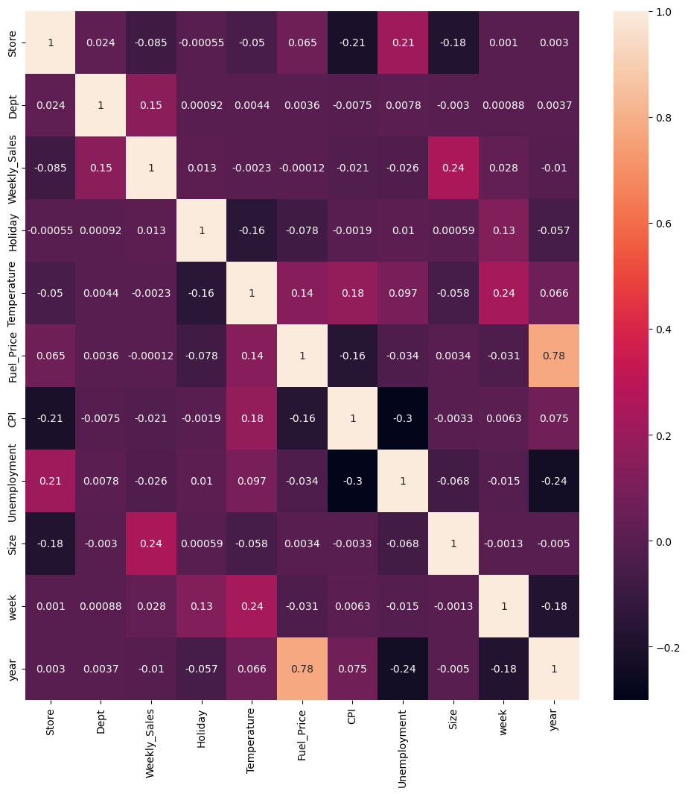
Impact of Variables
Correlation between each of the attributes
Fuel Price and Year: The heatmap indicates a strong positive correlation between fuel price and year, suggesting a trend of increasing fuel prices over time.
Temperature and Weekly Sales: This positive correlation suggests that temperature might have an impact on weekly sales.
Size and Weekly Sales: The positive correlation between size and weekly sales suggests that larger stores tend to have higher sales. This can guide strategies for store expansion or inventory management.
Several attributes have weak or negligible correlations, suggesting that they may not significantly influence each other. For example, the correlation between holiday and other attributes is generally weak, indicating that holidays may not strongly affect other metrics.
Notes:
In this chart you can see the correlation between all variables in our dataset. We can see that the heatmap indicates a strong positive correlation between fuel price and year, 0.78. After further investigation, this is showing a trend of increasing fuel prices over time. Another set of variables we are interested in measuring the correlation between is temperature and weekly sales, as well as size and weekly sales, a value of 0.24.

Slide 16
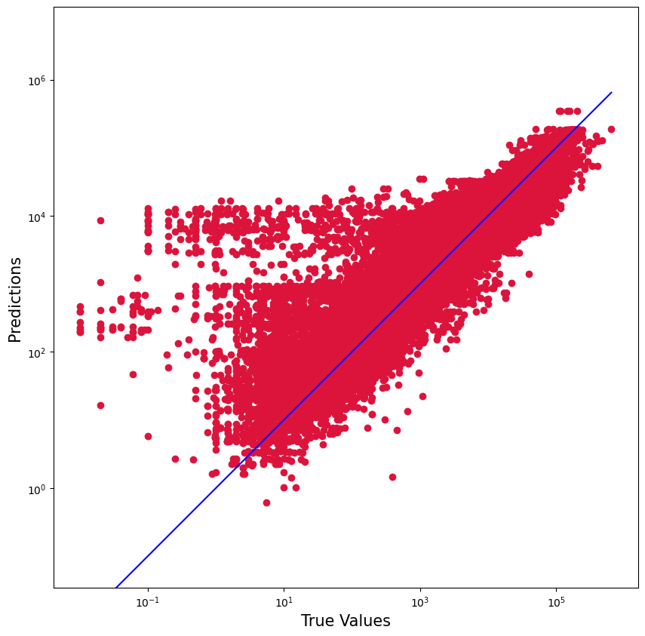
Using Machine Learning Models
The following models were selected to address our problem: Random Forest, Decision Tree, Logistic Regression, Linear Regression.
Random forest:
We're predicting the store's weekly sales and comparing these predictions to true values of predictor. With a 92% accuracy rate, the plot suggests that the Random Forest model performs well overall. Most predictions are concentrated near the blue diagonal line, indicating a good fit to the data. Wider dispersion of points from the line suggests areas where the model's predictions deviate from the true values. Outliers (points far from the diagonal) represent predictions with high errors.
Notes:
One of the machine learning methods we chose to use to predict the true values of weekly sales based on the data we have. The accuracy rate of the predictions given by this algorithm suggests that the random forest model performs very well overall. The chart illustrates the blue line as the prediction line for the data, and the red dots represent the true values. As we can see, the predictions fit the true values very well.

Slide 17
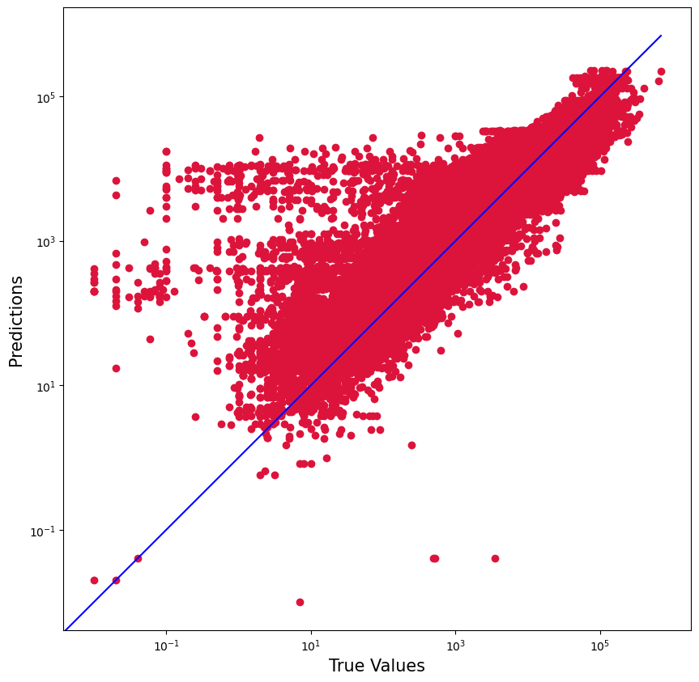
Decision Tree
The Decision Tree model achieved an accuracy rate of 91.5%, indicating strong predictive capability. The proximity of the data points to the blue diagonal line suggests that the model generally predicts well. Outliers are visible, these outliers might indicate cases where the model struggles with complex or unusual data patterns, suggesting areas for model improvement or data pre-processing.
The dispersion in predictions could result from overfitting, where the model learns specific patterns in the training data but fails to generalize well to unseen data. The variability and outliers suggest that the model may benefit from additional tuning, pruning, or the use of ensemble techniques to reduce overfitting.
Notes:
The simple decision tree model was also a method that we used to predict weekly sales values, which did also give a good result with 91.5% accuracy. Again, we are using a blue line here to show the predicted values and the red points to illustrate the true values of the data. Here we see a few more outliers, which may indicate cases where the model is not able to predict data points that do not follow a simple pattern. We could use more pre-processing of the data to help assist the model be more accurate.

Slide 18
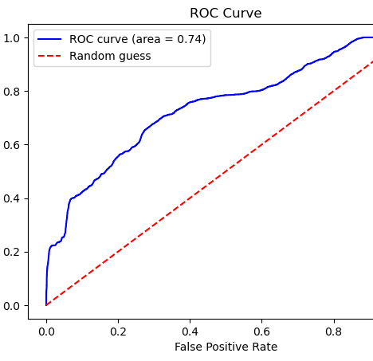
Logistic Regression
The ROC (Receiver Operating Characteristic) curve in this plot evaluates the performance of a logistic regression model. It helps visualize how well the classifier distinguishes between classes at varying thresholds, providing insight into the model's overall effectiveness.
This curve plots two parameters: True Positive Rate and False Positive Rate
The ROC curve's position above the diagonal and the AUC value of 0.74 show that the logistic regression model has predictive value, with a 92% accuracy rate indicating strong overall performance. While the model is effective, the curve's spread and distance from the top-left corner suggest there may be room for improvement through further tuning or additional feature engineering.
Notes:
Here, we have a plot the red line is showing predictions based on random guess. The ROC curve is shown in blue and is showing how well the classifier is distinguishing between classes at varying thresholds.

Slide 19
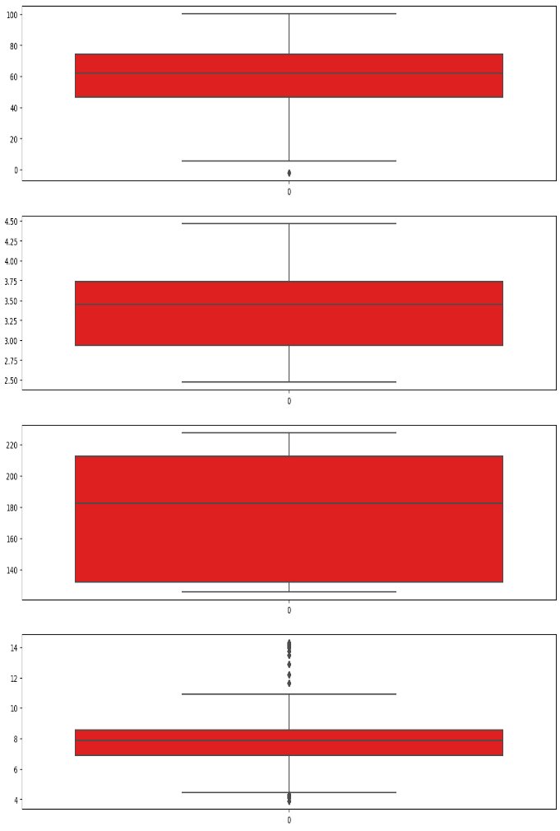
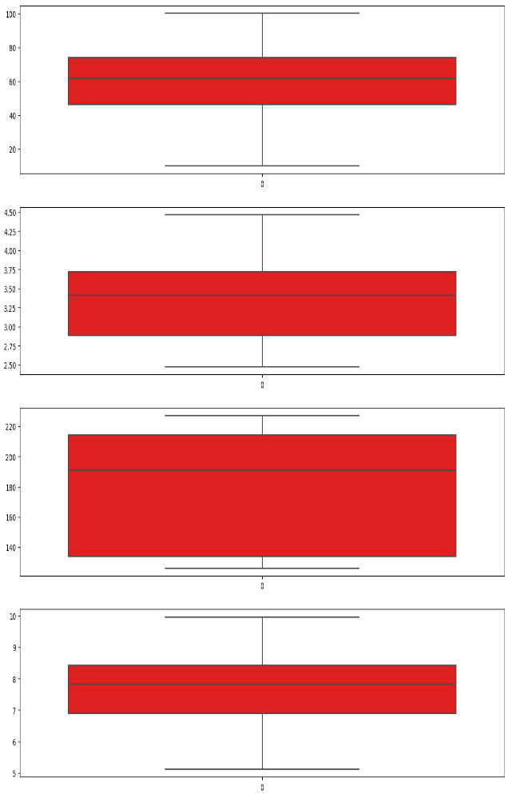
Temperature, Fuel_Price, CPI, Unemployment
Linear Regression
These outliers can skew linear regression results, leading to inaccurate predictions and increased error. By identifying outliers with box plots, you can remove them from the dataset before training the linear regression model. This process helps improve the model's accuracy.
The plot displays the predictions versus true values for a linear regression model. The linear regression achieved an accuracy of 81.7%. Several outliers are visible, suggesting predictions that significantly deviate from true values. An accuracy rate of 81.7% suggests the linear regression model is reasonably accurate but has room for improvement.
Notes:
The boxplots on the right show the outliers that were present when we ran simple linear regression. There are a fair few bit of outliers which were present, as seen in the box plots on the left hand side. The right hand side represents the box plots after the outliers have been removed. This has helped us to achieve 81.7% accuracy with linear regression model. However,

Slide 20

User Interface and Application (Walmart sales analysis prediction)
Out of the four models, only a few can take three input features and predict a numerical value for weekly sales. These include Random Forest, Decision Tree, and Linear Regression. Among these models, Random Forest proves to be the most suitable for our data, which is why we selected it for further testing and eventual implementation
Our web application has visualizations that shows the correlation matrix which tells correlation between the variables like department, weekly sales, temperature and holiday which is user- friendly. It contains three different phases, they are visualization, input, and output
We attempted to build the user interface (UI) using a Streamlit application. This framework enables the creation of interactive and data-driven web applications, allowing users to visualize data and interact with various features in a simple and intuitive way.
Outputs of the web application looks like:

Slide 21
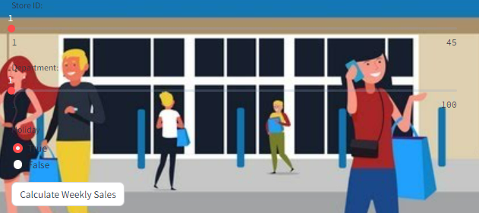
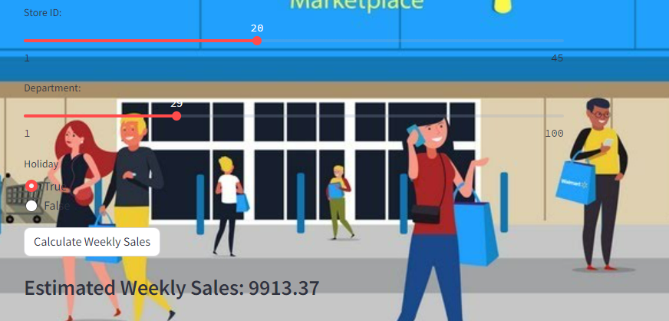
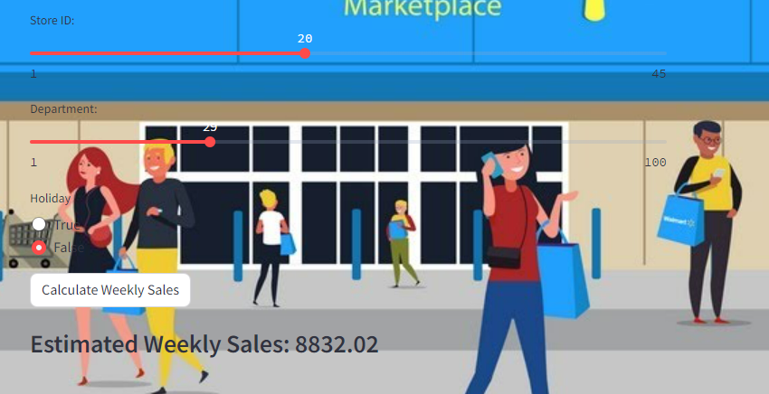
Input and Output for web application:
User input fields: Store id, Department, holiday, calculate weekly sales
Case 1:
Store number 20 and department number 29 on holiday week sales would be 9913.37.
Case 2:
Similarly, Store number 20 and department number 29 on non-holiday week sales would be 8832.02.

Slide 22
HYPOTHESIS | RANGE | YES/NO
Does the rise in fuel prices discourage customers from visiting the store? | No Impact | NO
Do the weather changes prevent the customer from visiting the store? | Major Impact | YES
Does the store sales increases during holidays sessions? | Minor Impact | YES
Does the level of unemployment affect store sales? | ModarateImpact | YES
Conclusion:
Holiday weeks contribute to a slight increase in weekly sales, indicating a moderate impact during these periods. Sales tend to dip in extreme weather conditions, with a noticeable improvement when temperatures are moderate. In contrast, fluctuations in fuel prices show no significant effect on sales. Overall, the data suggests that weather and holidays are more reliable indicators of sales trends, while fuel prices play a less decisive role. In addition, from part 3 we can predict weekly sales based on the holiday factors.

Slide 23

THANK YOU

